Slide 1
Woodland Public Schools
Facilities and Safety Report
November 2020

Slide 2
FACILITIES REPORT
3 Year Asbestos Surveillance Audit
Along with the 6 month internal periodic surveillance audits, the Asbestos Hazard Emergency Response Act (AHERA) rules state that all school buildings that contain asbestos must be inspected by an accredited inspector every three years. Three of our schools fall into that category, Columbia, Woodland Middle School and Yale Elementary. The inspector goes through each of the schools and inspects the installations to ensure that all locations are stable and not disturbed. The three year inspection was completed 12/8 with no significant findings.
Gutter Replacement
During the winter break, we will start the replacement of gutters at WMS. The project in its entirety has nearly 2000 feet of gutters to be replaced. This replacement will also included new down spouts.
Fire System Inspections and Backflow Flow Testing
As part of our normal shutdown activities, each school will have flow testing done on the fire systems to ensure they operate properly. During this period we will also be testing all of the districts backflow devices. These devices protect domestic water systems from possible contamination sources.
Fire System Monitoring
Johnson Controls will be installing cell phone communicators at each school that will be connected to the schools fire systems. These new system will be replacing the existing analog communication devices.

Slide 3
FACILITIES REPORT
Team High Expansion
The new portable building for the TEAM High expansion arrived on 12/9. After a short period of being stuck in the mud, the building halves were put in position. They will be leveled and aligned with the existing building over the next two days. The next step will be to remove the demising wall, install electric, carpet, the hallway between the two buildings, install ramps, and give the building a new paint job. We are looking at mid January for the final occupancy.
Final Water Tie-In
Tie-in for the new piping system for the green gym/auditorium and the CTE buildings at WMS will be completed Tuesday, 12/15. This will require a line bore from the meter base on Park Street to the old utility tunnel that runs beneath the Middle School complex. Once the mainline is in, there will be a couple of terminations, and then the project will be complete. This project was funded with grant dollars.
Annual Inspections and Maintenance
December is a busy month for our group. We will be completing numerous projects and annual inspections throughout the district. We have boiler inspections, carpet installs, bleacher inspections, and numerous other maintenance activities required by preventive maintenance or regulatory compliance.

Slide 4
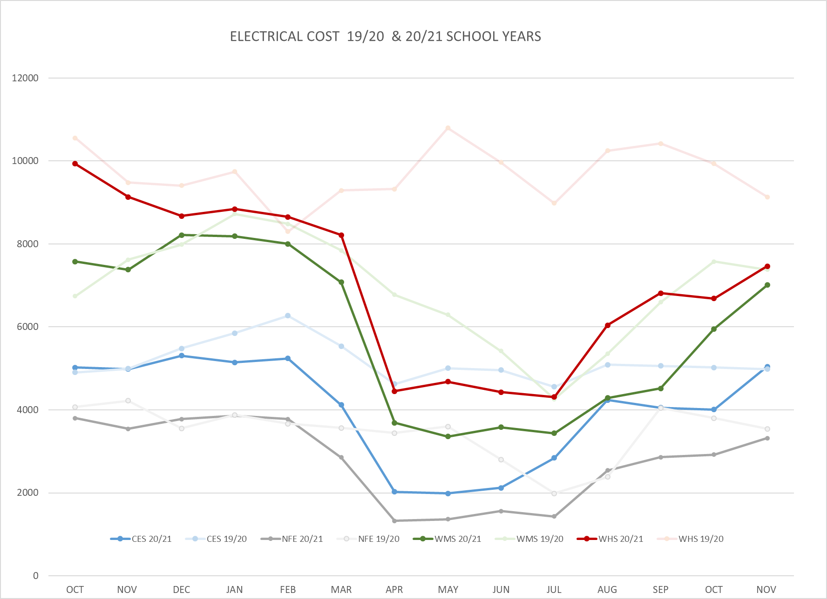
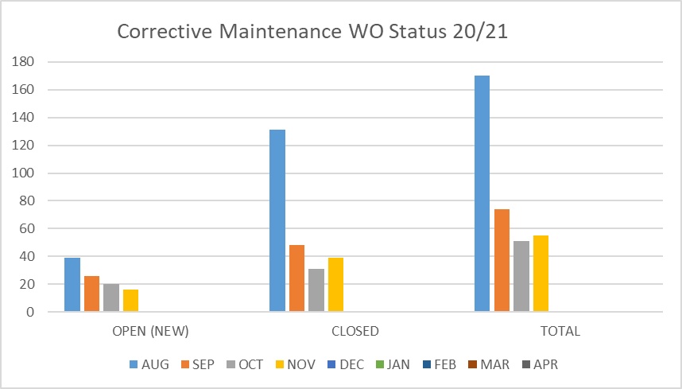
FACILITY CHARTS – POWER COST AND WORK ORDER STATUS

Slide 5
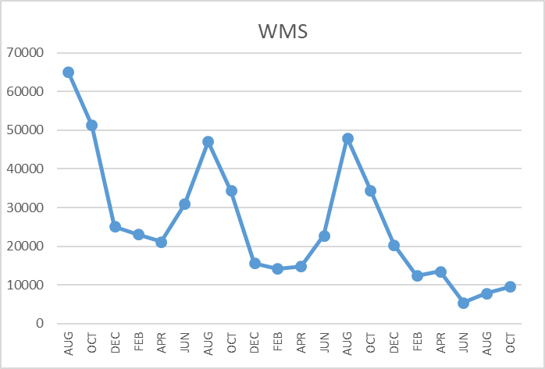
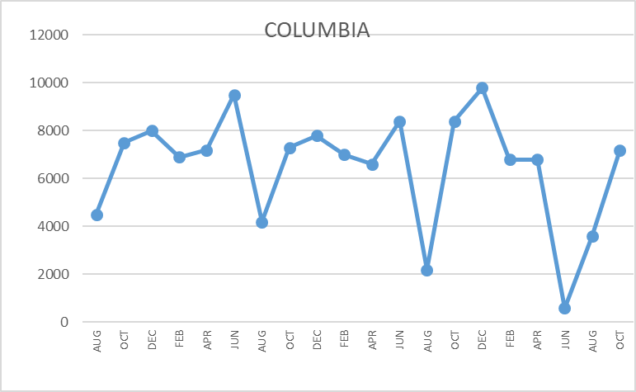
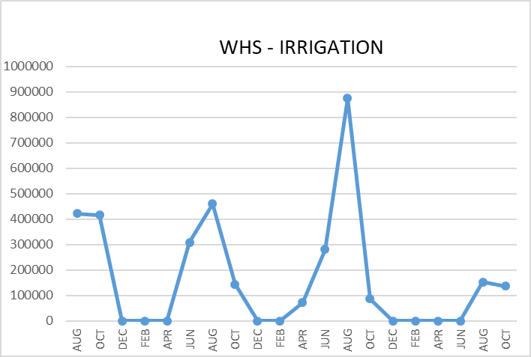
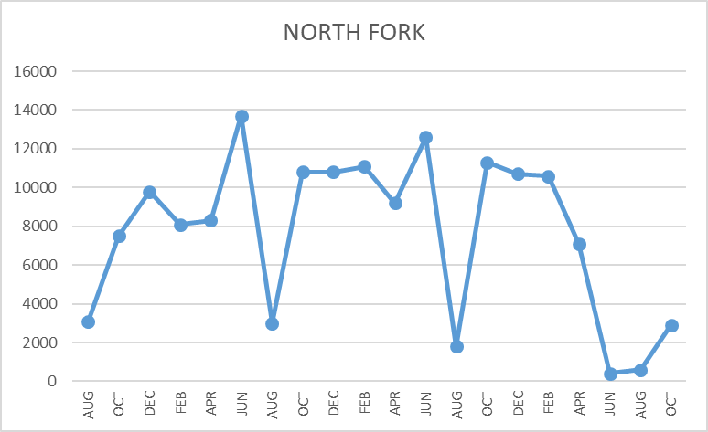
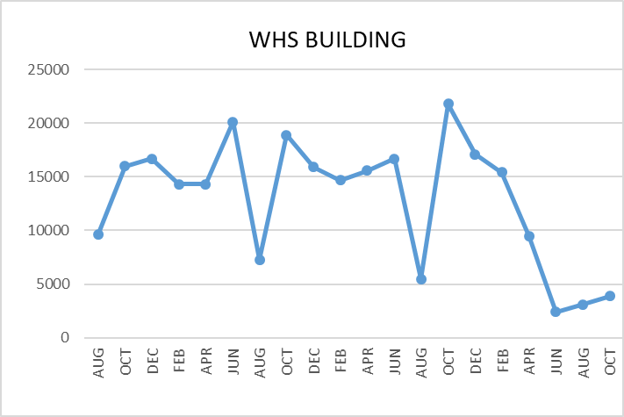
FACILITY CHARTS WATER USAGE WHS, NFES, WMS, CES
Note
Water charts are updated every two
months. Next update to these charts in the January 2021 report
The WMS chart includes the following 7 meters: 755 Park high and low flow, BO and TEAM High, PIT house, bus barn, athletic field, and the DO. All of these meters are totaled on the WMS graph, but each data point is recorded separately to aid in identifying leaks.

Slide 6
Safety Summary
Staff Accidents/Incidents
NFES -Staff member cut leg on bleacher that was missing a cover
WMS – DSP student injured care giver during changing operation
WMS – DSP student bit employee
CES – Student struck employee multiple time in the face
Student Accidents/Injuries
No student accidents or incidents recorded

